Slide 1


How Might We
Reframing User Pain Points into Actionable Innovation Opportunities

Slide 2

What is "How Might We"?
A structured reframing technique used between the Define and Ideate phases to spark creative brainstorming and constructive problem-solving.

Slide 3

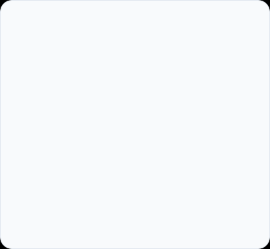
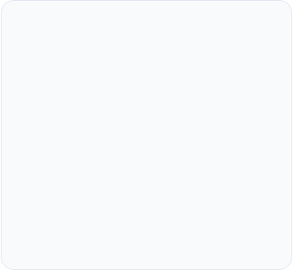
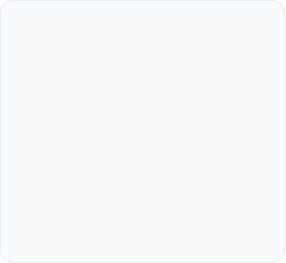



Deconstructing the Phrase
"How"
"Might"
"We"
Assumes that solutions exist and we possess the capability to solve the challenge. It instills immediate optimism and a forward-looking orientation.
Grants permission to explore wild, creative, and unconventional ideas without early judgment or commitment to a single outcome.
Emphasizes team collaboration and shared responsibility, reinforcing that innovation is a collective effort rather than an isolated task.

Slide 4
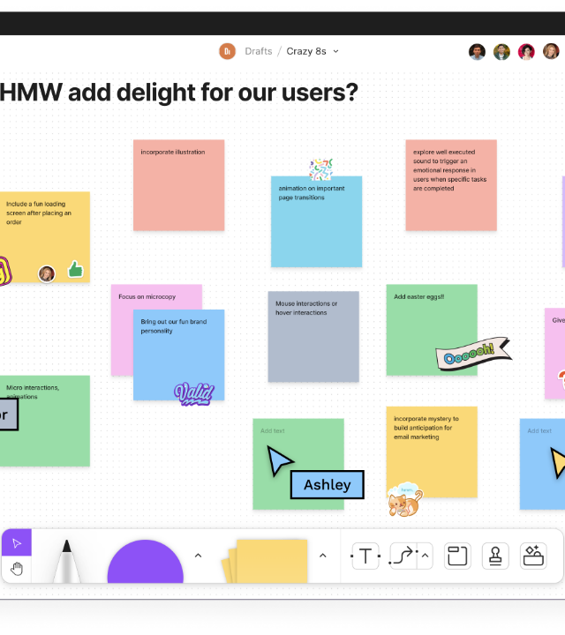

The HMW Formula
1. Target User: Ground the prompt in a specific persona discovered during user research.
2. Core Action / Need: Address the root problem or friction point without prescribing a fix.
3. Desired Impact: Define the positive outcome or feeling you aim to deliver.
CORE FORMULA
How Might We + [User] + [Action/Need] + so that [Intended Impact]?

Slide 5

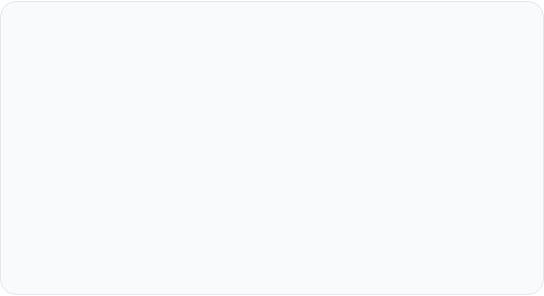
Finding the "Sweet Spot" Scope
Flawed Scopes
Optimal Scope
Too Broad: "How might we redesign education?"
Result: Overwhelming, vague, and offers no clear starting point for brainstorming.
Balanced HMW: "How might we make homework management feel rewarding and achievable for busy students?"
Too Narrow: "How might we add a blue submit button?"
Result: Presumes a fixed solution and kills creative exploration.
Why it Works: It pinpoints the exact user distress while remaining agnostic about the final solution, unlocking dozens of inventive ideas.

Slide 6

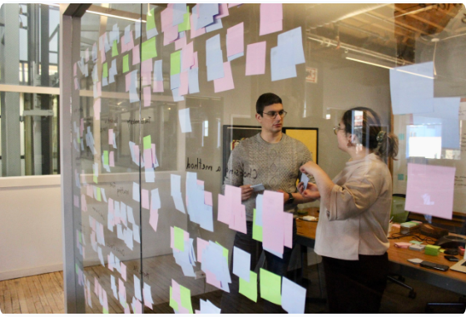
4 Key Rules for Writing Strong HMWs
•
Anchor in Real Research: Base questions directly on empathy interviews and user observations.
•
Stay Solution-Agnostic: Focus strictly on framing the challenge, not hinting at pet solutions.
•
Phrase Positively: Use constructive verbs like enhance, empower, or simplify instead of prevent or reduce.
•
Promote High Volume: Ensure the question can spark at least 10–20 unique brainstorming ideas.

Slide 7






HMW Reframing Examples
User Insight / Problem | Weak HMW (Flawed) | Strong HMW (Reframed)
Users feel overwhelmed by long signup forms. | Too Narrow / Solution-led How might we create a 2-step progress bar on signup? | Generative & Positive How might we make onboarding feel effortless and swift?
Remote employees miss casual team bonding. | Too Broad How might we fix remote work culture? | Balanced & Focused How might we create spontaneous moments of joy for remote workers?
Patients get anxious waiting for lab results. | Negative Framing How might we stop patients from worrying about tests? | Empathy & Action-driven How might we provide peace of mind during health waiting periods?

Slide 8

Ready to Ideate!
"How might we turn our next user pain point into a groundbreaking feature?"

Slide 9


Image Sources
https://cdn.prod.website-files.com/64a30b704b78b8d713bcdb90/64a7404489994d4886c9d240_the-5-whys-behind-sticky-notes-in-design-thinking-and-how-to-best-use-them-banner.png
Source: www.differential.com
https://fuzzymath.com/wp-content/uploads/2020/08/IMG_6272-1-scaled.jpeg
Source: fuzzymath.com

